Slide 1
Using Decision Tree to predict body fat
Group 8: Vaishinavi Borwankar, Xilin Qiao, Yifei Ye, Yuchen Dou

Slide 2
Introduction
For this module we used the dataset of 252 men with measurements of their percentage of body fat and various body circumference measurements to conduct analysis, aiming to predict body fat using a model of our choice with simplicity, accuracy and robustness.
There are many ways to approach this problem and we decided to use a correlation matrix to first find the attributes that are most correlated with body fat percentage. Then we compared the models we had in mind to see which model yield the most accurate prediction.

Slide 3
Data Cleaning
We decided to omit the 2 rows with potential outlier data from our dataset. One has a body fat of 0 and the other has a body fat of 45.1. We deemed these data statistically impossible in a real world setting.
IDNO | BODYFAT
182 | 0
216 | 45.1
Final cleaned data: n = 250 (from n = 252)
Notes:
For this step we decided to omit the 2 rows with potential outlier data from our dataset. One has a body fat of 0 and the other has a body fat of 45.1. We deemed these data statistically impossible in a real world setting. As a result, we ended up with 250 rows of data for our analysis.

Slide 4
Selection of the Model
The Model is selected based on the following criteria: Mean Absolute Error, Mean Squared Error and R^2.
The analysis is done using several models like Linear Model, Decision Tree, Random Forest and PCR.
It is observed that the Decision Tree Model has the lowest MAE and MSE values and the highest R^2 value.

Slide 5
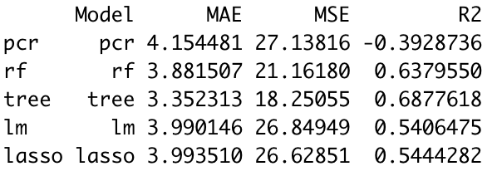
Results:

Slide 6
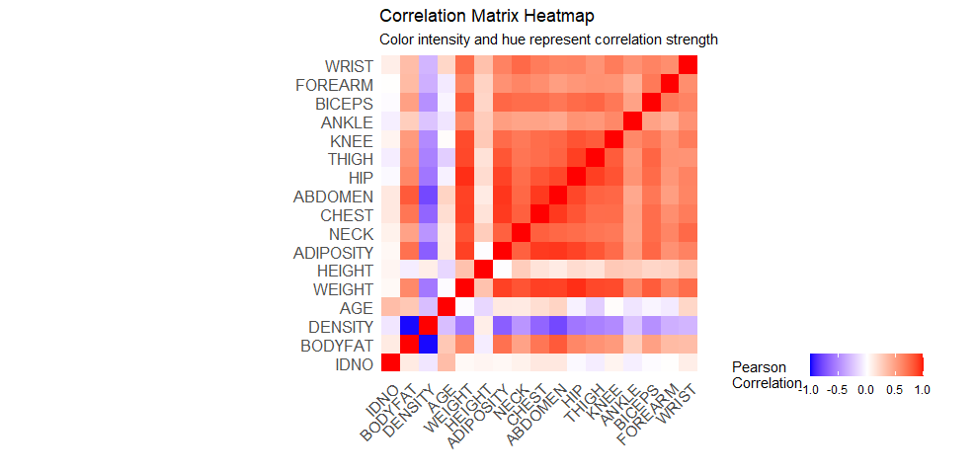

Variable selection - Predictive Accuracy
While each additional variable might increase the model's predictive power slightly, there's a point of diminishing returns.
Top 3 correlated independent variables with ‘body fat’ are:
ABDOMEN: 0.80
ADIPOSITY: 0.71
CHEST: 0.69

Slide 7
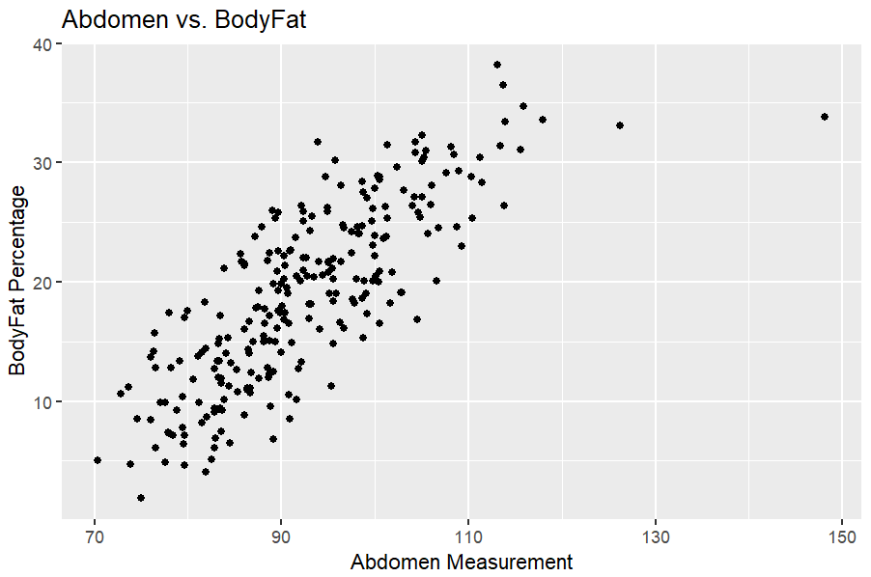
Scatterplot of Abdomen vs BodyFat %

Slide 8
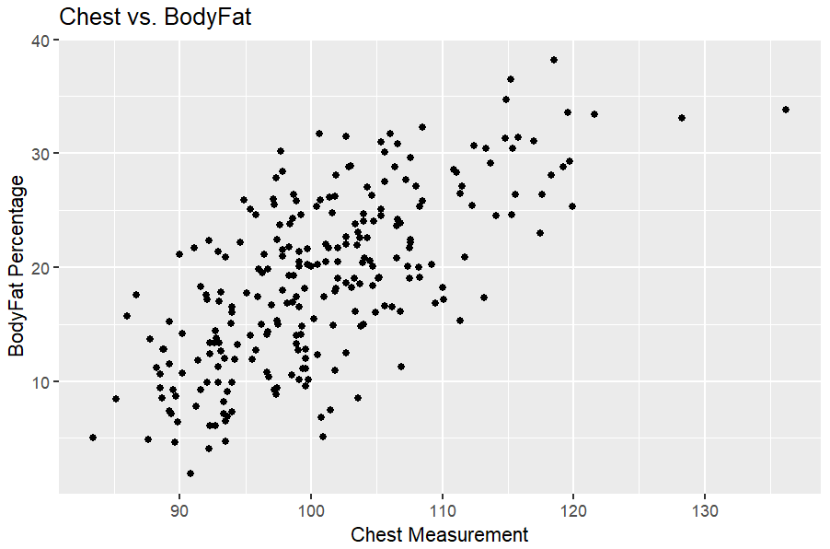
Scatterplot of Chest vs BodyFat %

Slide 9
Variable selection - Multicollinearity
Variance Inflation Factor
The Variance Inflation Factor (VIF) quantifies the severity of multicollinearity. A VIF above 5 (some use 10) signals a problematic amount of collinearity.
Result
The VIF shown below shows there are indeed collinearity, regression model might be distorting based on this.
VIF among the top 3 correlated variables:
ABDOMEN | ADIPOSITY | CHEST
8.31 | 7.09 | 7.40

Slide 10
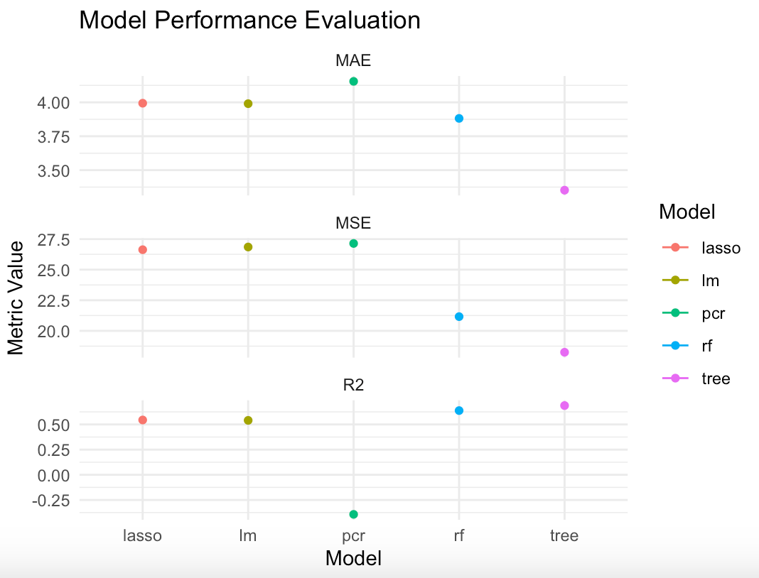
Final Model Analysis

Slide 11
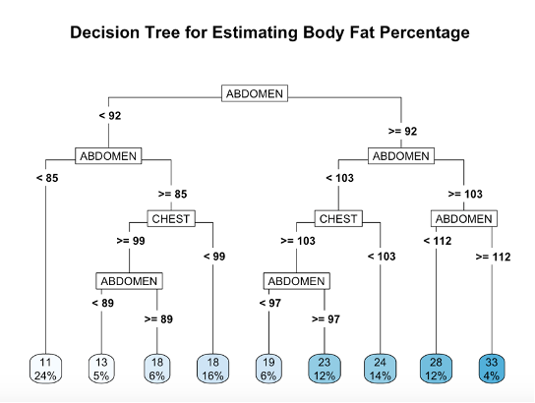

Slide 12
Strengths and Weaknesses
Strengths:
Major highlight of the model is its interpretability and ease of use.
Captures non-linear relationships in the data.
Weaknesses:
Model might be underfitted due to loss of information from other variables.

